Slide 1

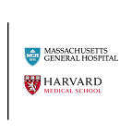
Machine Learning Tools in Computational Neuroimaging: From Connectomes to FIT
Center for Precision Psychiatry
Prof. Susan Whitfield-Gabrieli
Javid Dadashkarimi, PhD
Postdoctoral Fellow MGH/Harvard

Slide 2
Outline
Functional Connectomes
  Tool 1: Visualization
  Tool 2: Statistical Tools
  Tool 3: Data-driven Methods with Optimal Transport
Fetus, Infant, and Toddler (FIT) Neuroimaging
  Tool 4: Automated Fetal Brain Extraction
Results & Final Remarks

Slide 3
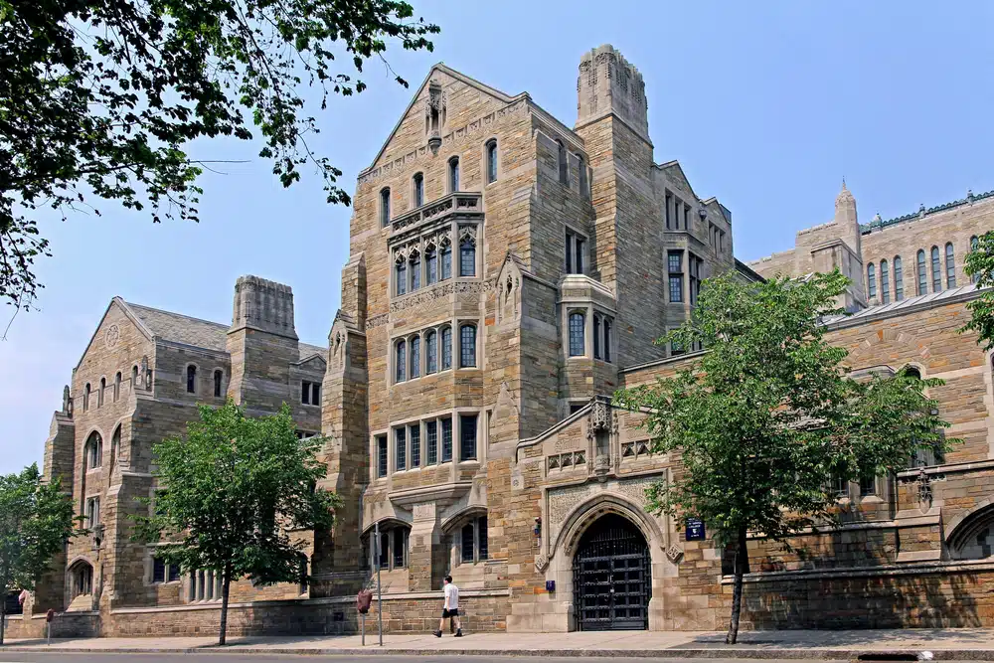



Predoctoral Training
I graduated in 2023, Computer Science, Yale University

Slide 4
Outline
Functional Connectomes
  Tool 1: Visualization
  Tool 2: Statistical Tools
  Tool 3: Data-driven Methods with Optimal Transport
Fetus, Infant, and Toddler (FIT) Neuroimaging
  Tool 4: Automated Fetal Brain Extraction
Results & Final Remarks

Slide 5
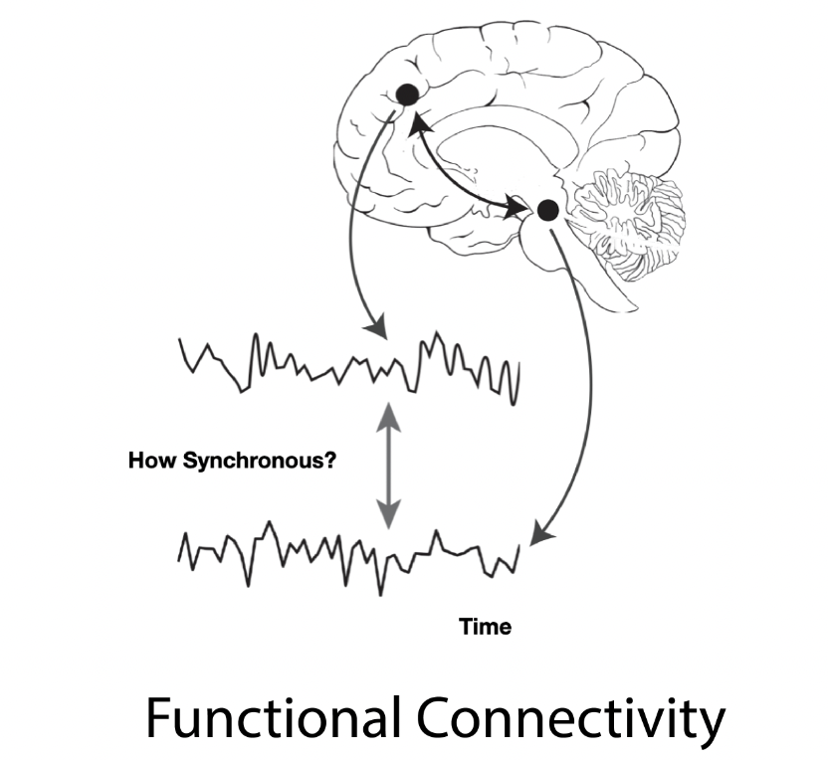
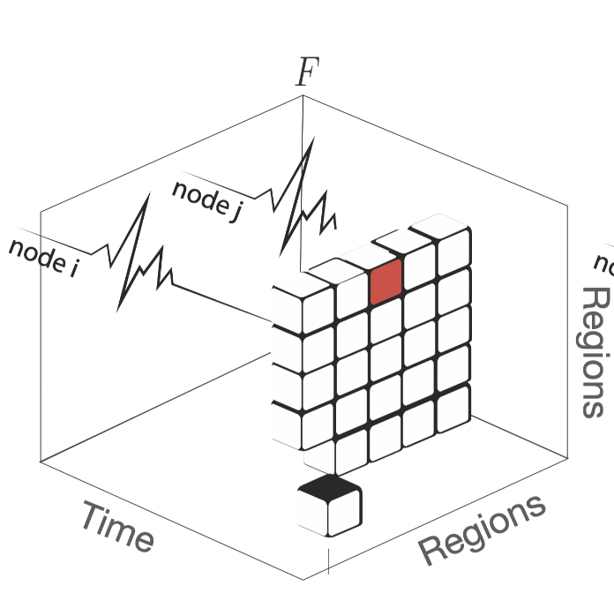
Functional Connectomes

Slide 6
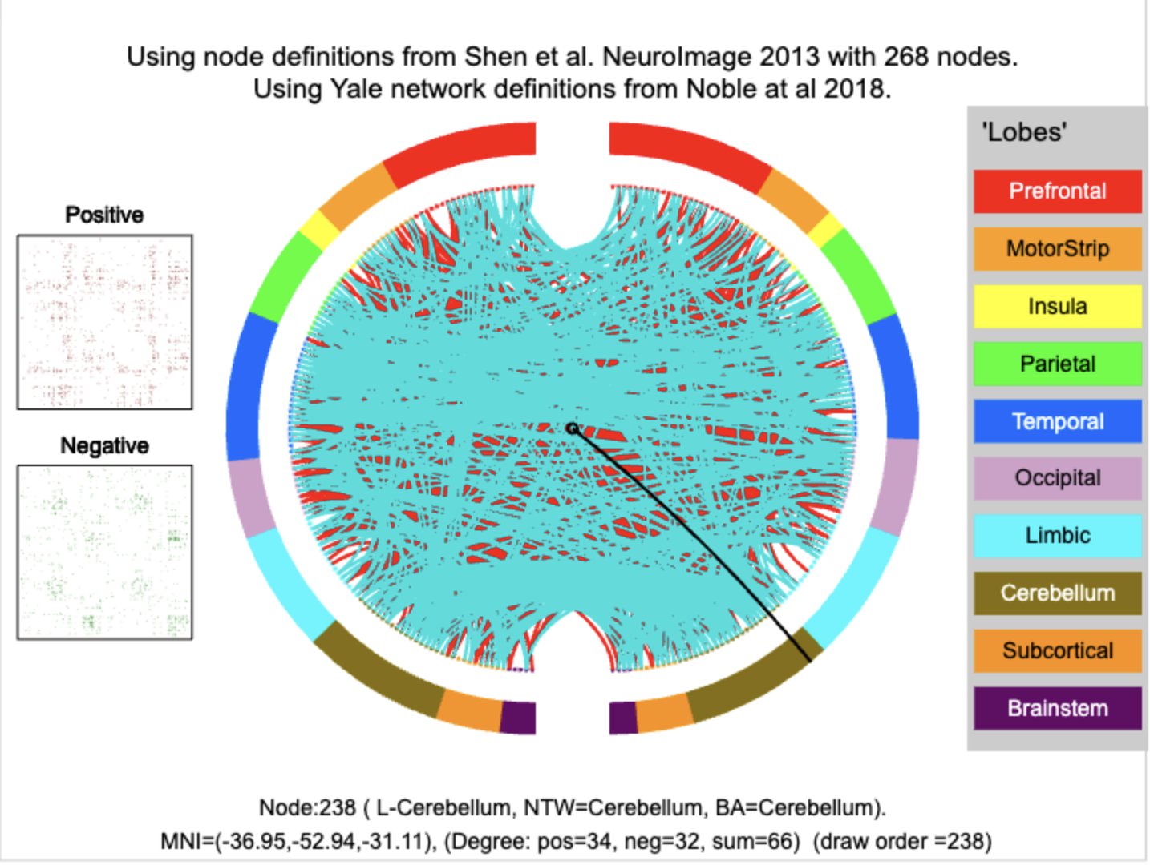
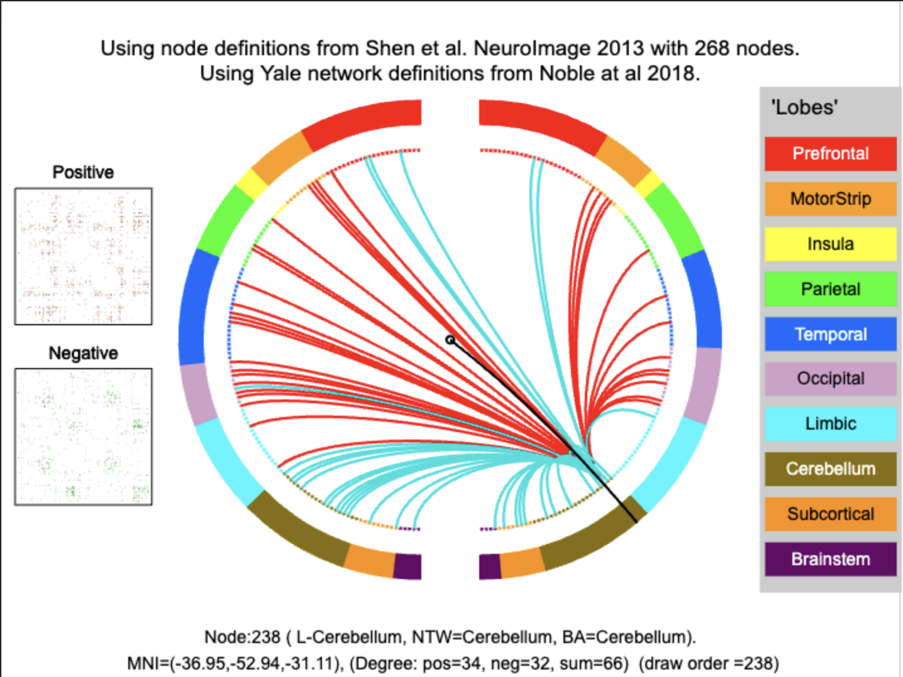
Tool 1: Visualization: Edge-level

Slide 7
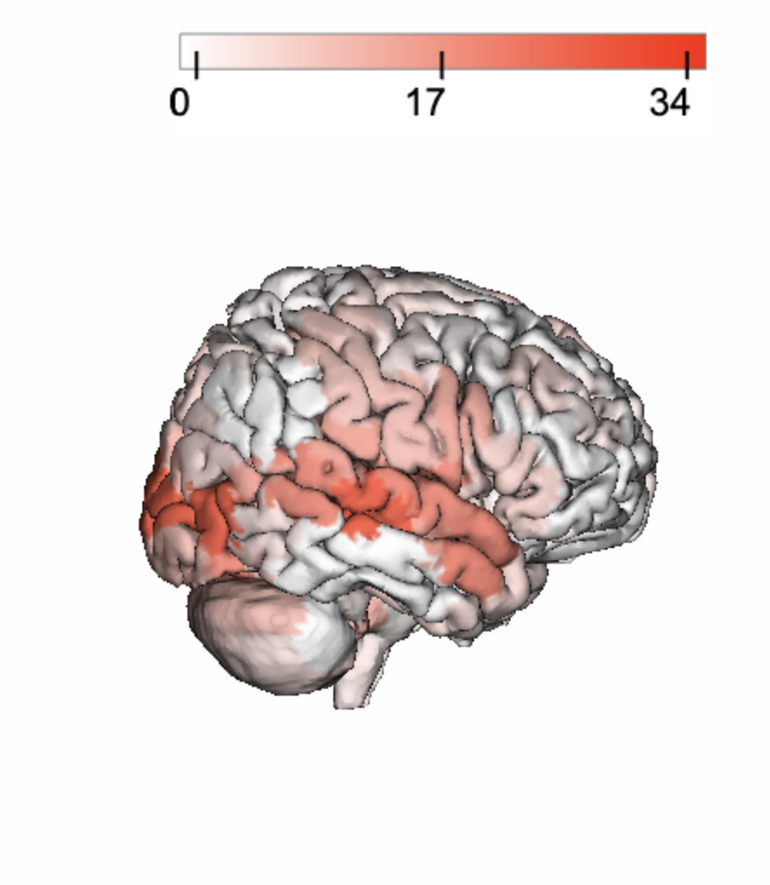
Tool 1: Visualization: Node-level

Slide 8

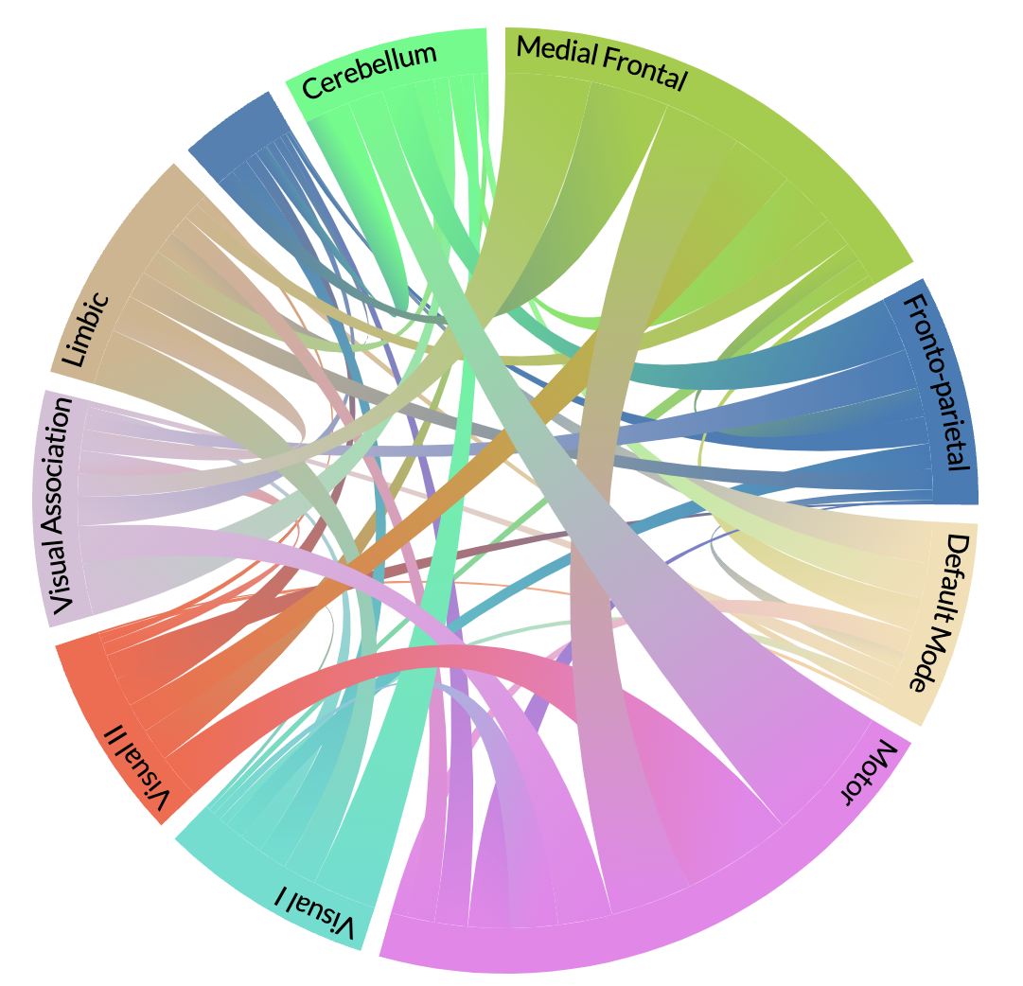
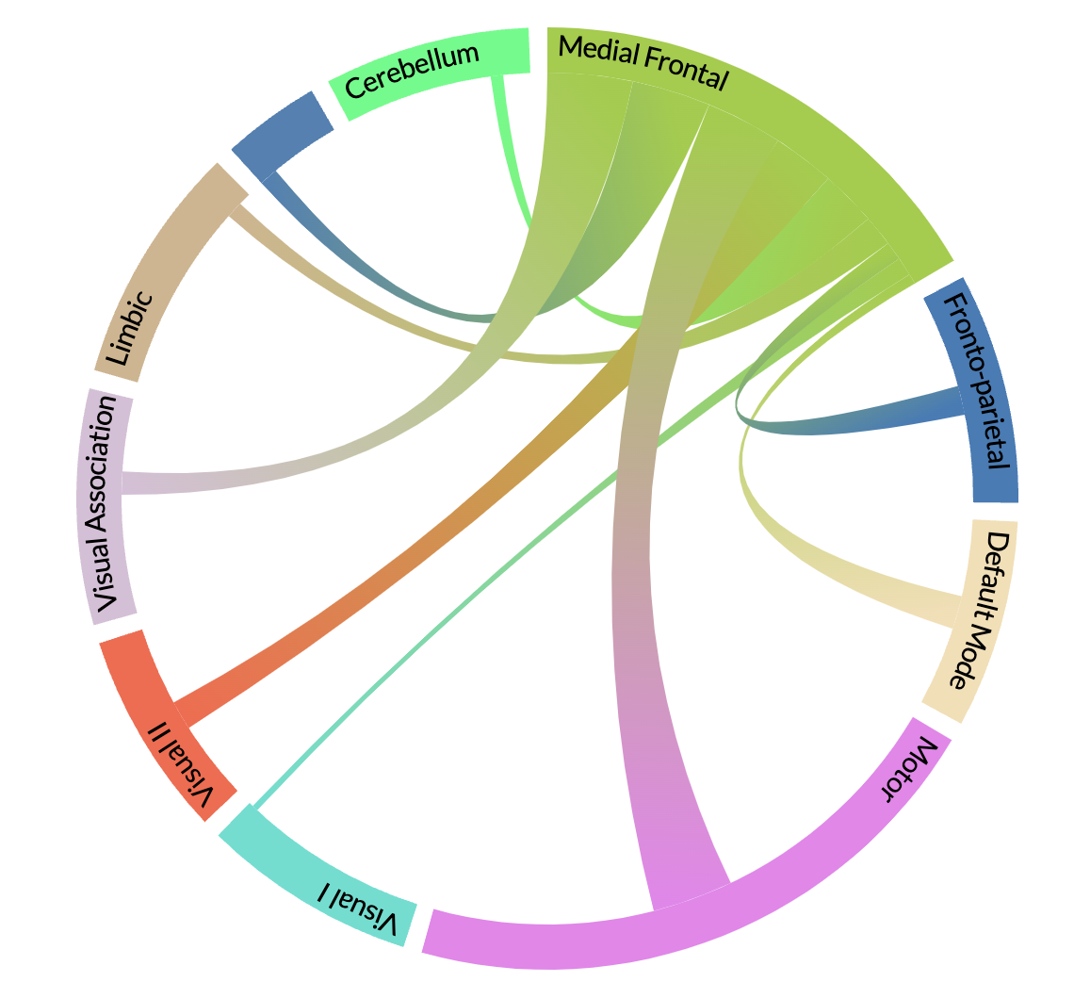
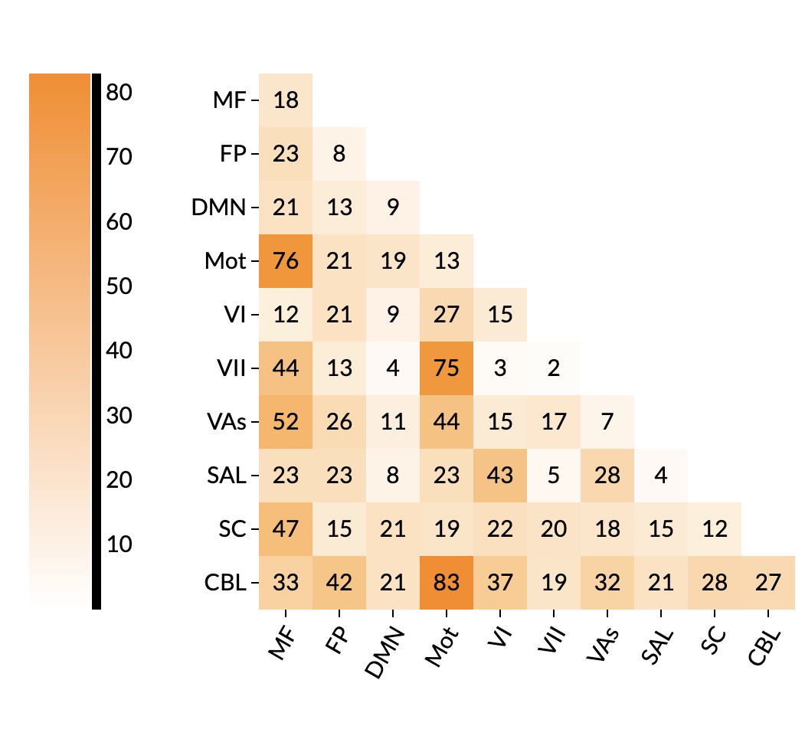
Tool 1: Visualization: Network-level
Chord Plots
Summary Matrix
https://bioimagesuiteweb.github.io/webapp/connviewer.html?species=human

Slide 9
Outline
Functional Connectomes
  Tool 1: Visualization
  Tool 2: Statistical Tools
  Tool 3: Data-driven Methods with Optimal Transport
Fetus, Infant, and Toddler (FIT) Neuroimaging
  Tool 4: Automated Fetal Brain Extraction
Results & Final Remarks

Slide 10
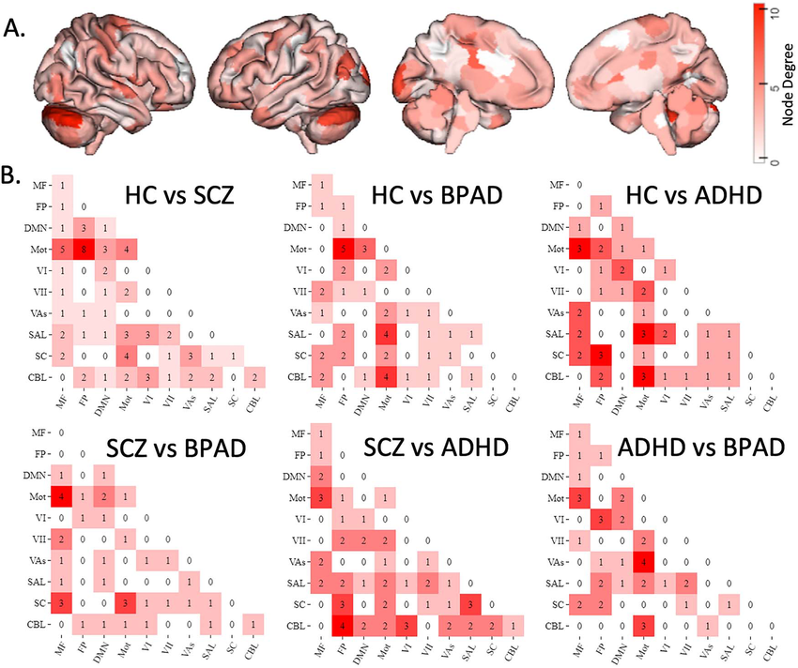
  Tool 2: Statistical Tools and T-test
The T-test is designed for one variable.
If we have multiple connectomes, we need advanced tools.
Barron, Daniel S. – Dadashkarimi, Javid -- et al. "Transdiagnostic, connectome-based prediction of memory constructs across psychiatric disorders." Cerebral Cortex 31.5 (2021): 2523-2533. APA

Slide 11
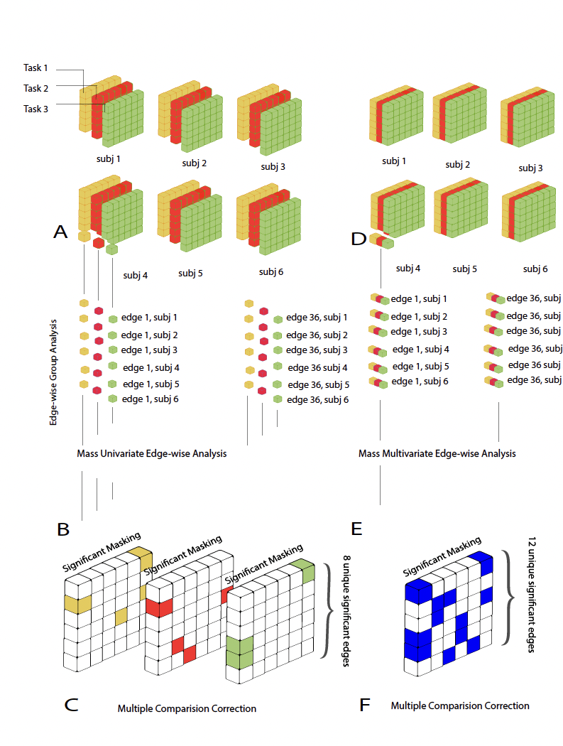
  Tool 2: Multi-variate Approach
We proposed Mass Multivariate Analysis of Variance (MANOVA) for multiple groups
The tool is available at https://github.com/YaleMRRC/CPM/tree/master
Dadashkarimi, Javid, et al. "A mass multivariate edge-wise approach for combining multiple connectomes to improve the detection of group differences." Connectomics in NeuroImaging, CNI, 2019 (Best Poster Award).

Slide 12
Outline
Functional Connectomes
  Tool 1: Visualization
  Tool 2: Statistical Tools
  Tool 3: Data-driven Methods with Optimal Transport
Fetus, Infant, and Toddler (FIT) Neuroimaging
  Tool 4: Automated Fetal Brain Extraction
Results & Final Remarks

Slide 13
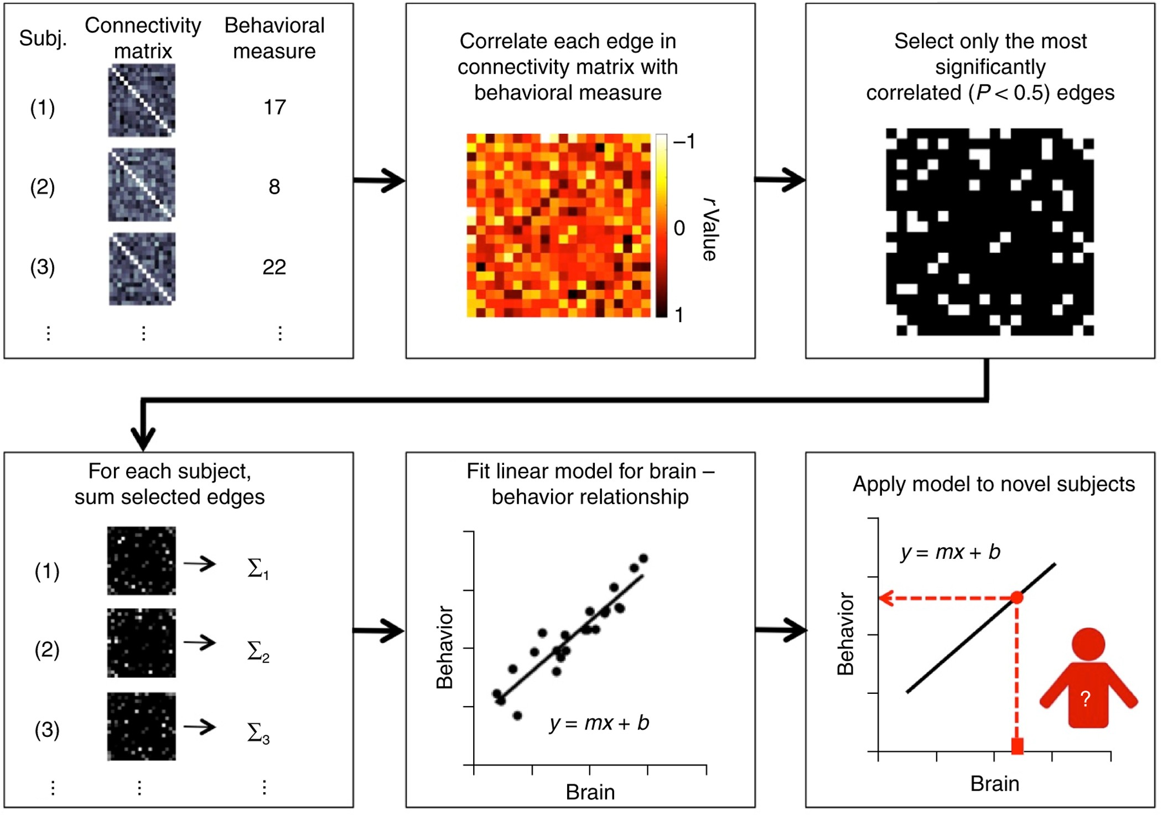
Tool 3: Data-driven Methods for Functional Connectomes
Predictive models reveal the brain's functional organization.
More data enhances predictive power.
However, connectomics data remain heterogeneous.
Shen, Xilin, et al. "Using connectome-based predictive modeling to predict individual behavior from brain connectivity." Nature Protocols 12.3 (2017): 506-518.

Slide 14
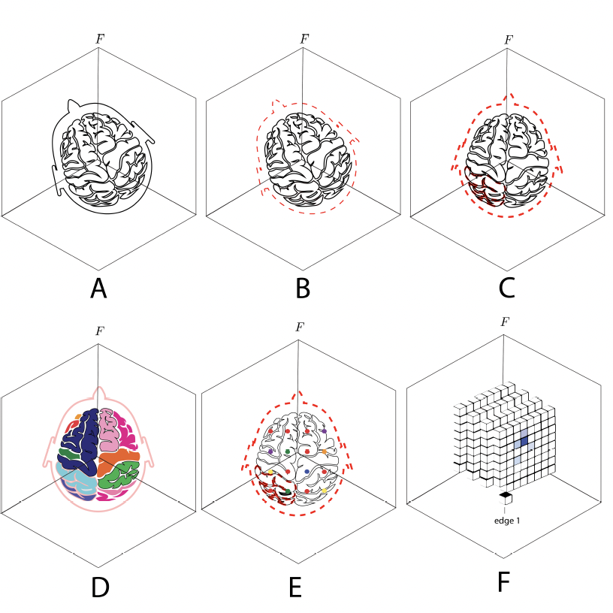
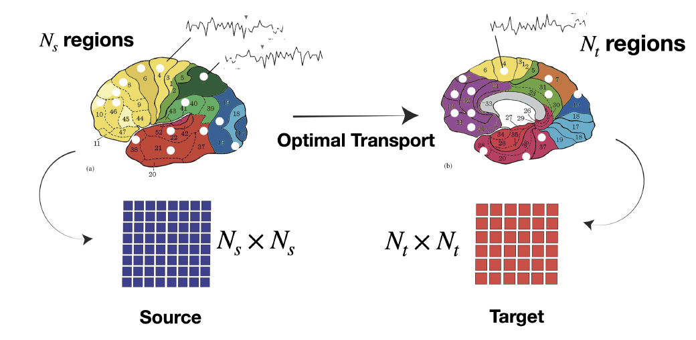
Tool 3: Data-driven Methods for Functional Connectomes
Connectomes derived from one atlas, are not directly comparable to those from a different atlas

Slide 15
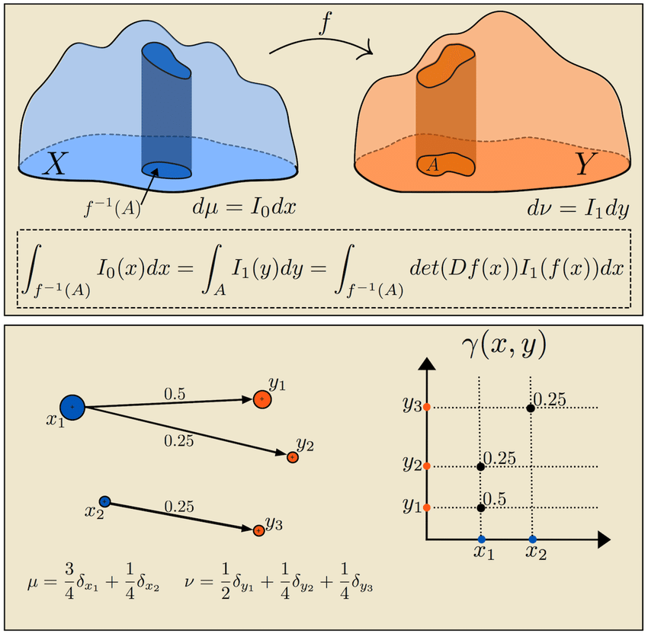
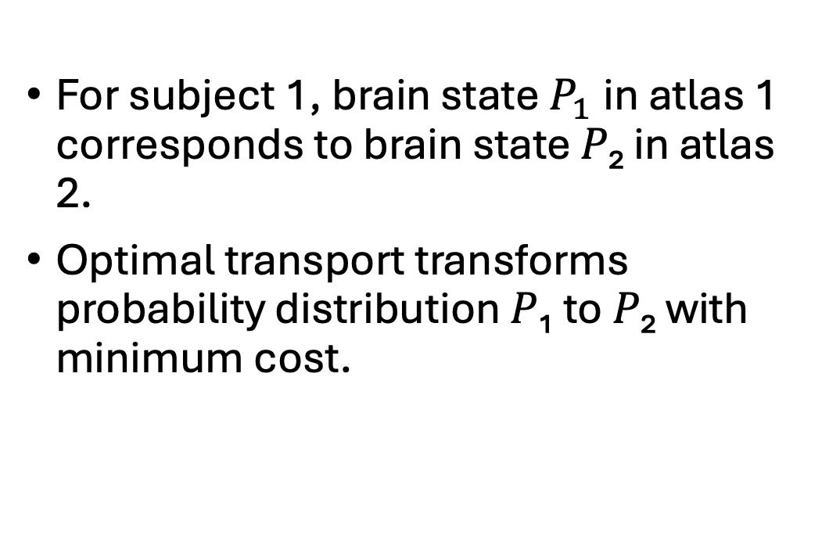
Tool 3: Data-driven Methods for Functional Connectomes
For subject 1, brain state$P_{1}$in atlas 1 corresponds to brain state 𝑃₂ in atlas 2.
Optimal transport transforms probability distribution 𝑃₁ to 𝑃₂ with minimum cost.
Peyré, Gabriel, and Marco Cuturi. "Computational optimal transport: With applications to data science." Foundations and Trends® in Machine Learning 11.5-6 (2019): 355-607.

Slide 16
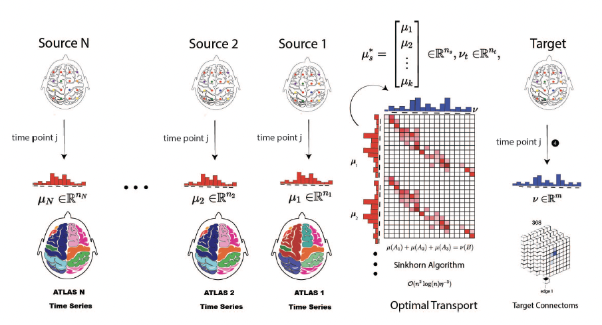
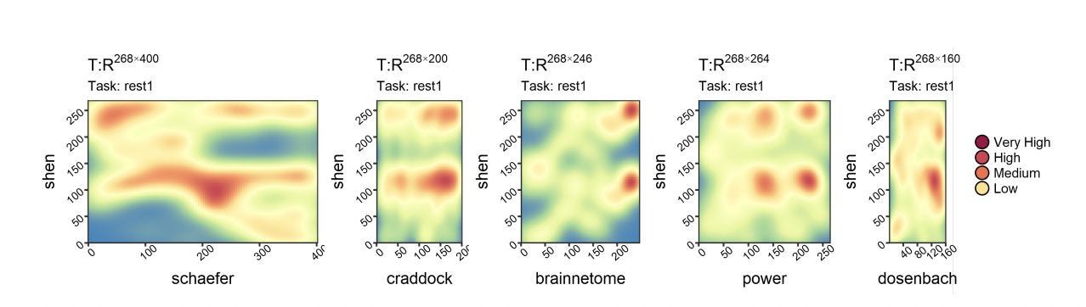
Tool 3: Cross Atlas Remapping via Optimal Transport (CAROT)
Pre-trained Transportation Policies

Slide 17
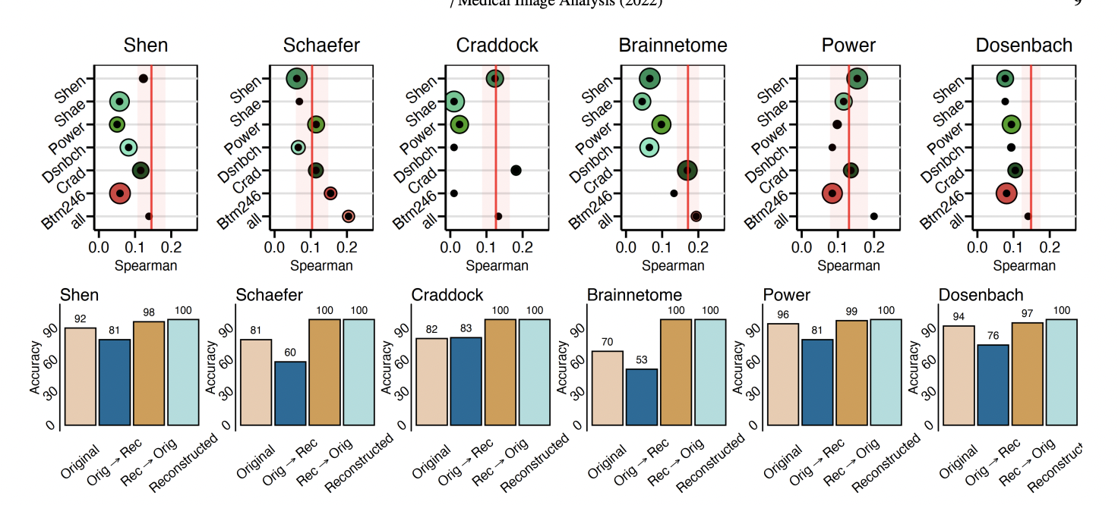
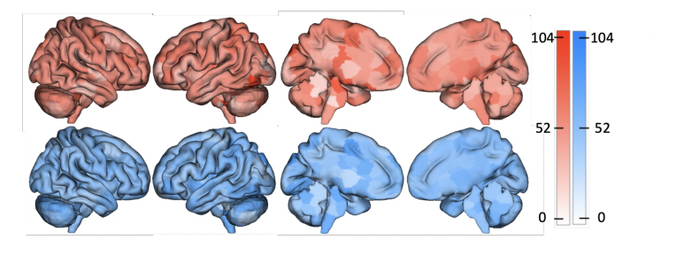
Tool 3: Cross Atlas Remapping via Optimal Transport (CAROT)
Fluid Intelligence Prediction
original
Reconstructed
Fingerprinting
Dadashkarimi, Javid, et al. "Cross Atlas Remapping via Optimal Transport (CAROT): Creating connectomes for different atlases when raw data is not available." Medical image analysis 88 (2023).
Liang, Qinghao, Dadashkarimi, Javid, et al. "Transforming Connectomes to “Any” Parcellation via Graph Matching." MICCAI Workshop on Imaging Systems for GI Endoscopy. (Best Paper Award).

Slide 18
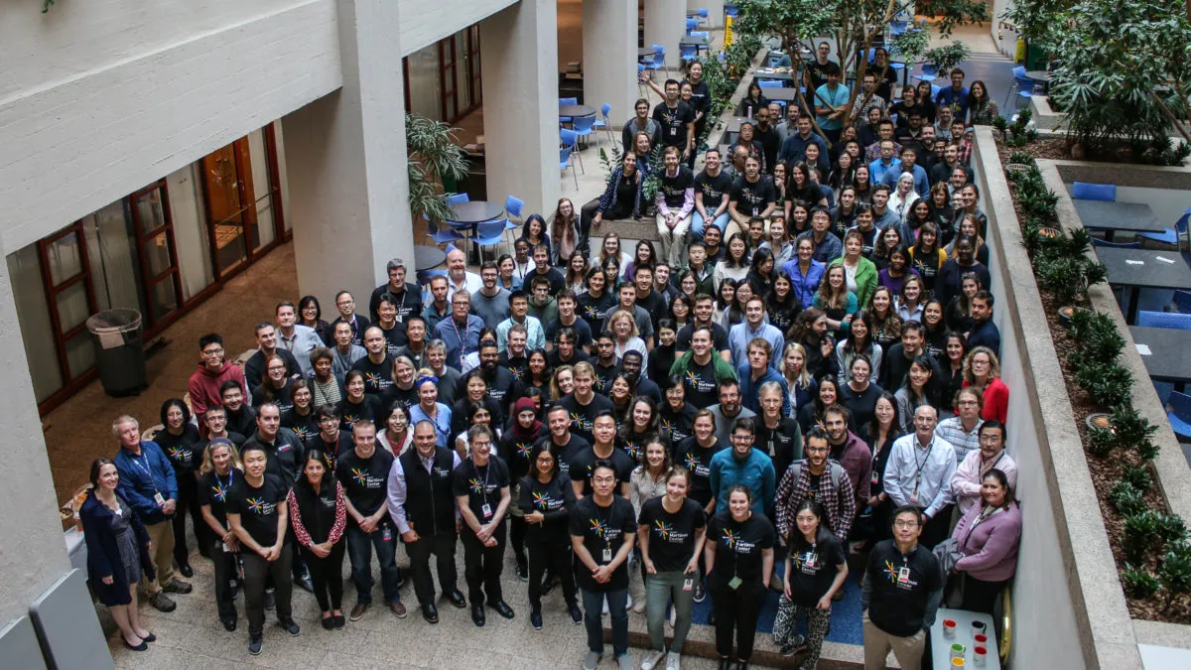
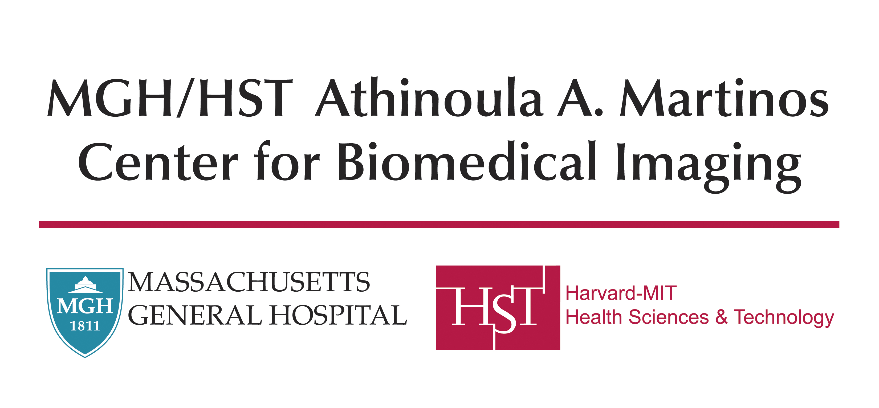
Postdoctoral Training
I joined the Martinos Center in August 2023.
Motivation: Tools for adults often struggle in early childhood and pre-natal periods.
Focus: My work focuses on fetal brain extraction and segmentation.

Slide 19
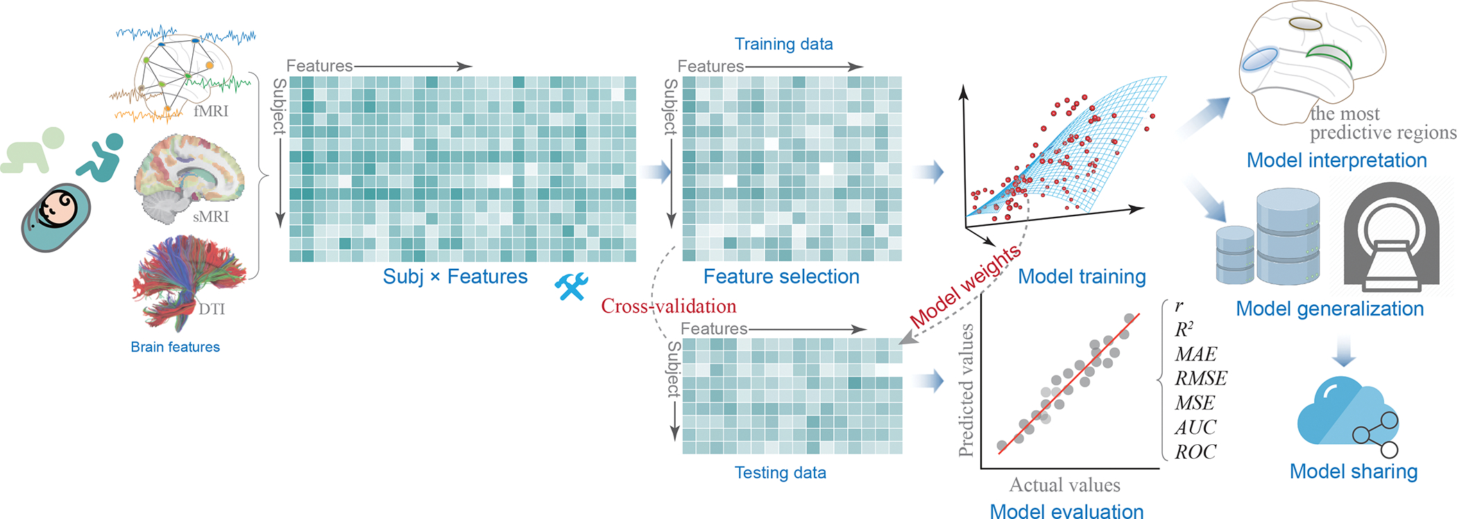
Motivation
Predictive models aid risk stratification and support interventions
Most models focus on children of school age or older
Fetal, infant, and toddler (FIT) periods are critical for mental health.

Slide 20
Outline
Functional Connectomes
  Tool 1: Visualization
  Tool 2: Statistical Tools
  Tool 3: Data-driven Methods with Optimal Transport
Fetus, Infant, and Toddler (FIT) Neuroimaging
  Tool 4: Automated Fetal Brain Extraction
Results & Final Remarks

Slide 21
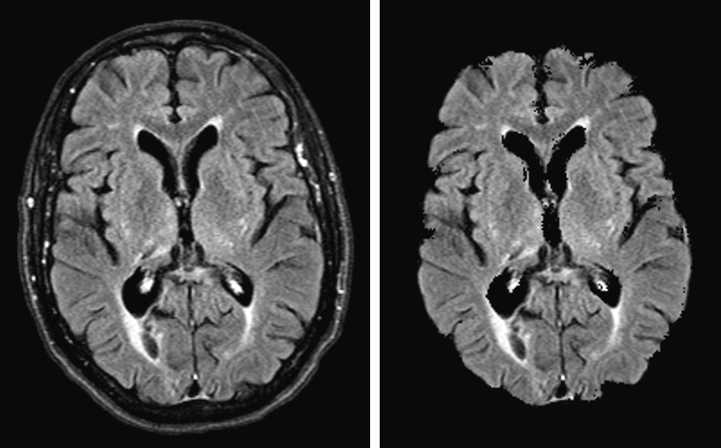
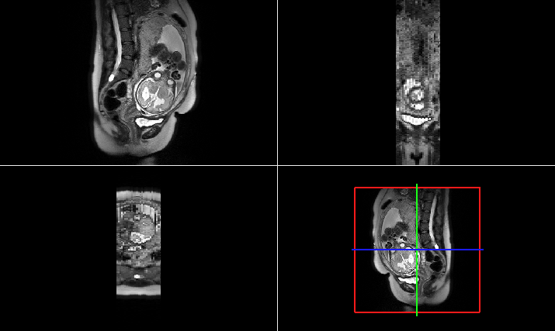
Fetus, Infant, and Toddler Neuroimaging (FIT)
Adult MRI
Fetal MRI
Hoopes, Andrew, et al. "SynthStrip: skull-stripping for any brain image." NeuroImage 260 (2022): 119474.

Slide 22
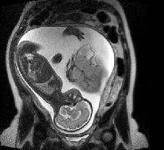
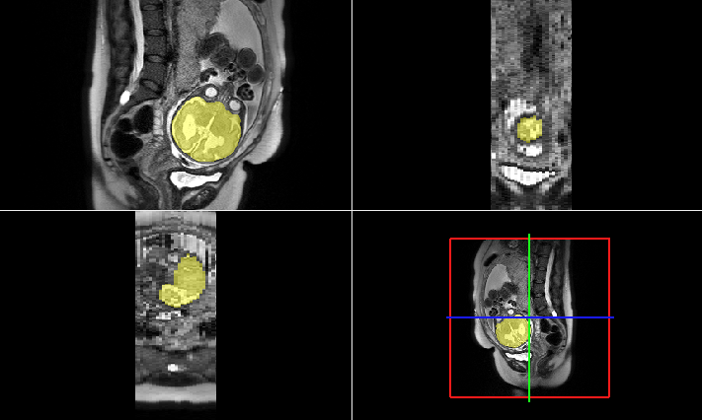
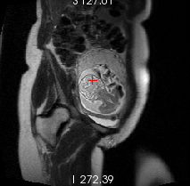
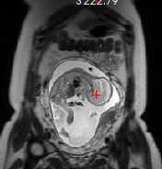
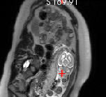
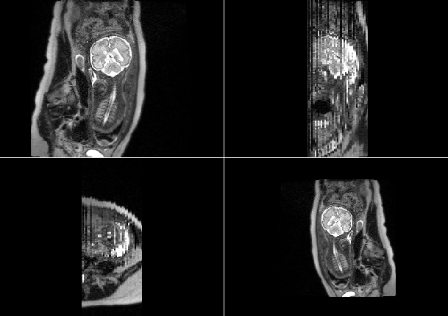


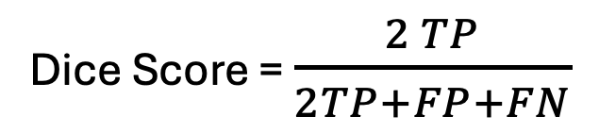
Fetus, Infant, and Toddler Neuroimaging (FIT)
Brains are different in size, shape, and orientation.
Brain masks are binary arrays
The dice coefficient is our main evaluation metric:
$$2×$$
Dice Score = $\frac{2 TP}{2TP+FP+FN}$
Dice Score =
Prediction
$$+$$
Ground Truth

Slide 23
Outline
Functional Connectomes
  Tool 1: Visualization
  Tool 2: Statistical Tools
  Tool 3: Data-driven Methods with Optimal Transport
Fetus, Infant, and Toddler (FIT) Neuroimaging
  Tool 4: Automated Fetal Brain Extraction
Results & Final Remarks

Slide 24
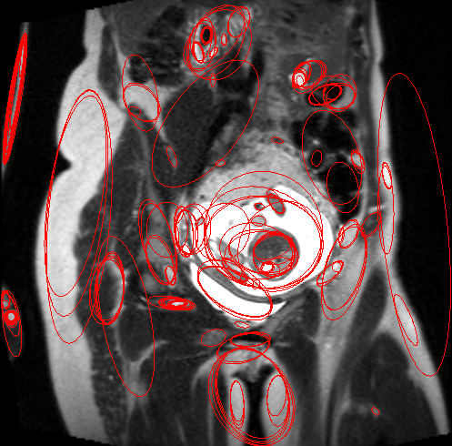
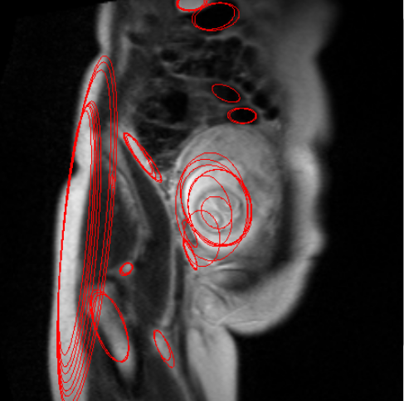
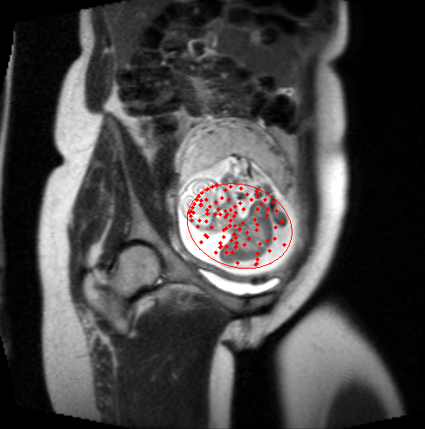
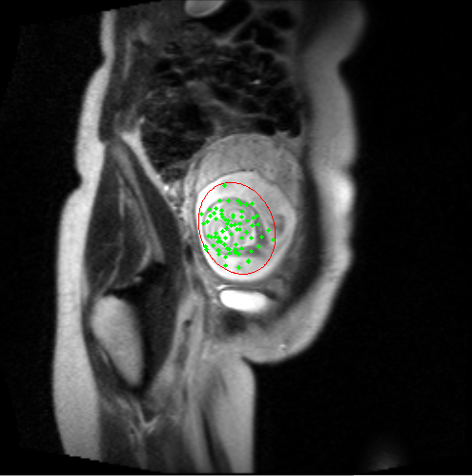
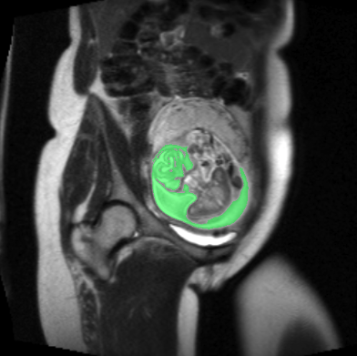
  Tool 4: Automated Fetal Brain Extraction
1
2
Early methods were based on maximally stable features
Random forest (RF) and conditional random field (CRF) used for classification (Keraudren et al)
3
4
5

Slide 25
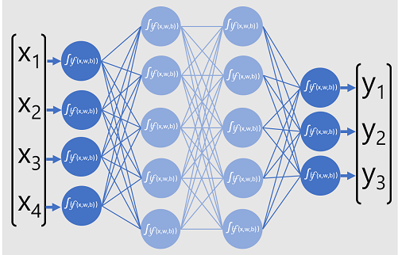
Deep Learning
Layered Structure: Multiple layers learn data patterns.
Feature Learning: Extracts features from raw data automatically.
Backpropagation: Optimizes by minimizing error.
Applications: Key in vision, NLP, and autonomous tech

Slide 26
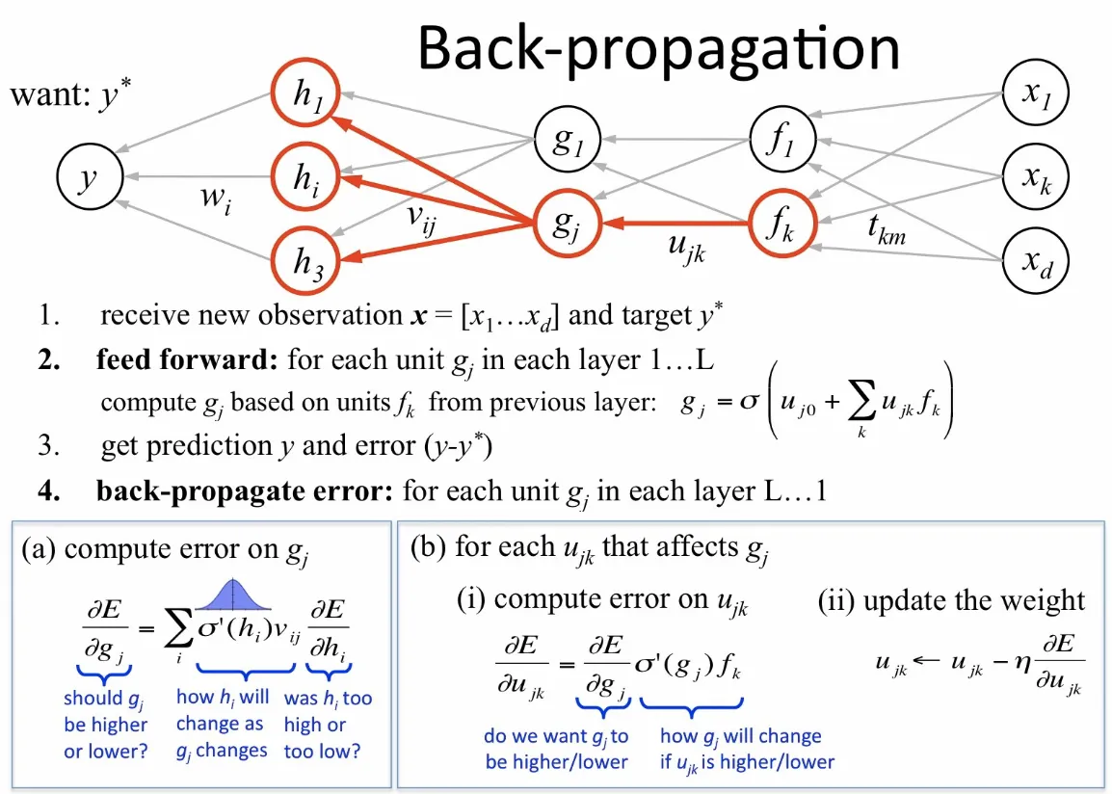
Deep Learning

Slide 27

Convolutional Neural Network (CNN)
Convolution Layers: Detect spatial patterns in data (e.g., edges, textures).
Pooling: Reduces dimensionality, preserving essential features.
Filters/Kernels: Learn hierarchical features through small, learnable filters.
Applications: Widely used in image processing, medical imaging, and video analysis.

Slide 28
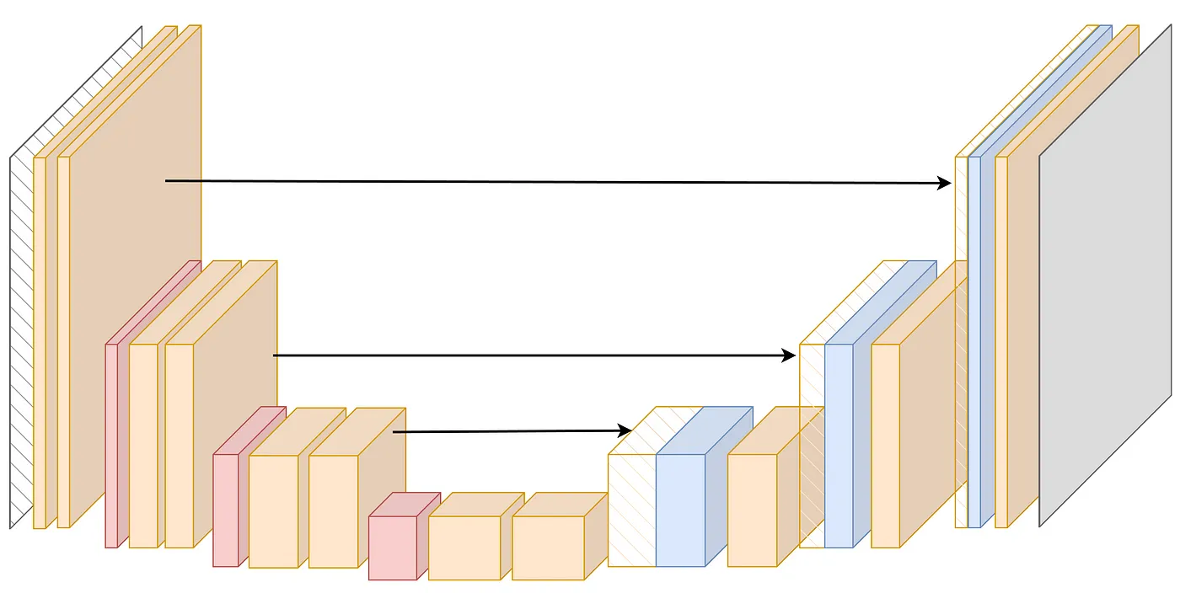
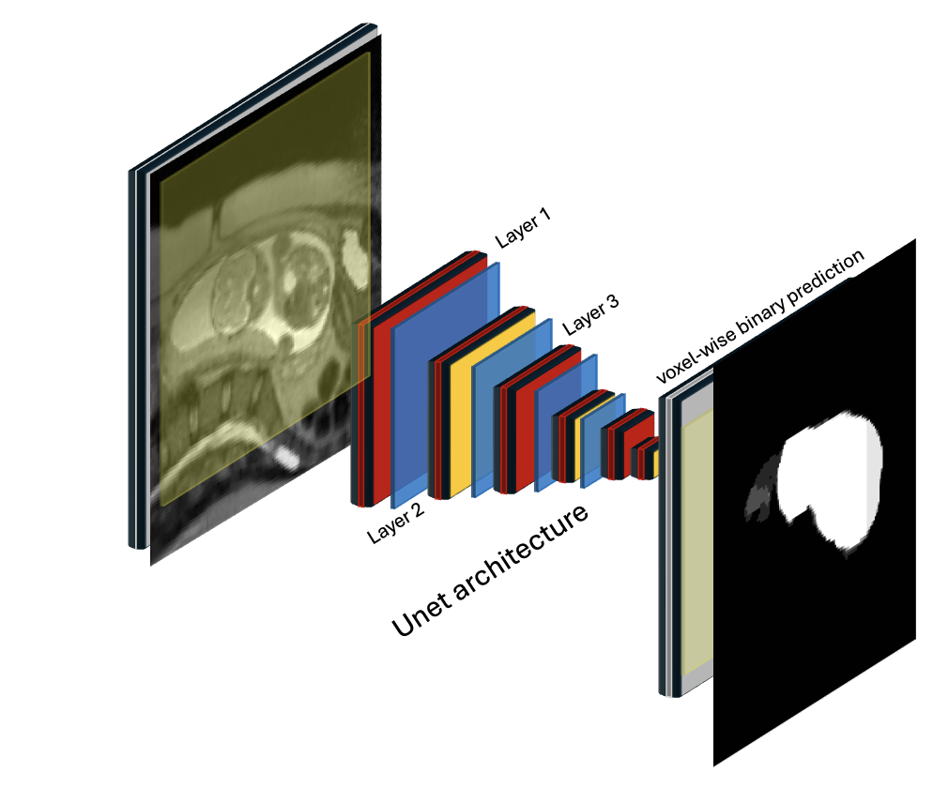
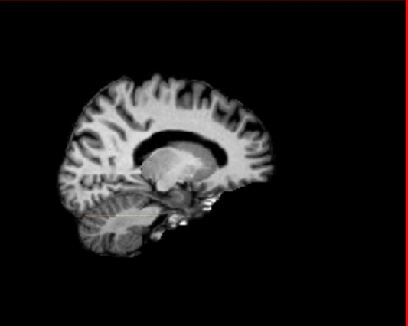
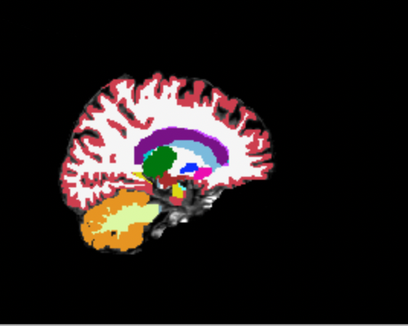
Tool 4: Automated Fetal Brain Extraction
Concatenate
Input Image
Deep learning (DL) models and U-Net are widely used for medical image segmentation.
We can adapt U-Net for masking tasks effectively.
down sampling
up sampling
Layer 1
Layer 3
Output
Segmentation
Layer 2
U-Net architecture
Salehi, Seyed Sadegh Mohseni, et al. "Real-time automatic fetal brain extraction in fetal MRI by deep learning." ISBI, IEEE, 2018

Slide 29
Tool 4: Challenges with HASTE
In Plane
Half-Fourier acquisition single-shot turbo spin echo imaging (HASTE) and echo-planar Imaging (EPI) techniques are fast and popular
High contrast in the plane, low contrast through the plane
Through the Plane

Slide 30
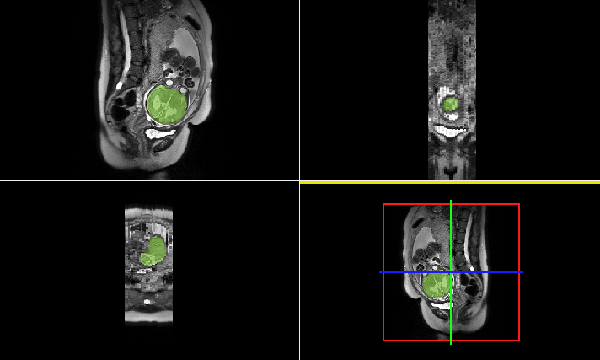
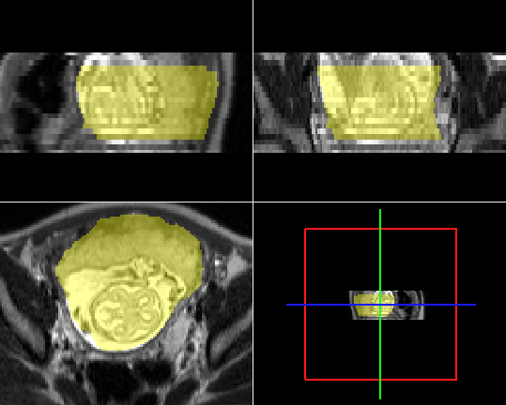
Tool 4: Challenges with 2D Models
35 Gestational Weeks (GW)
25 GW

Slide 31
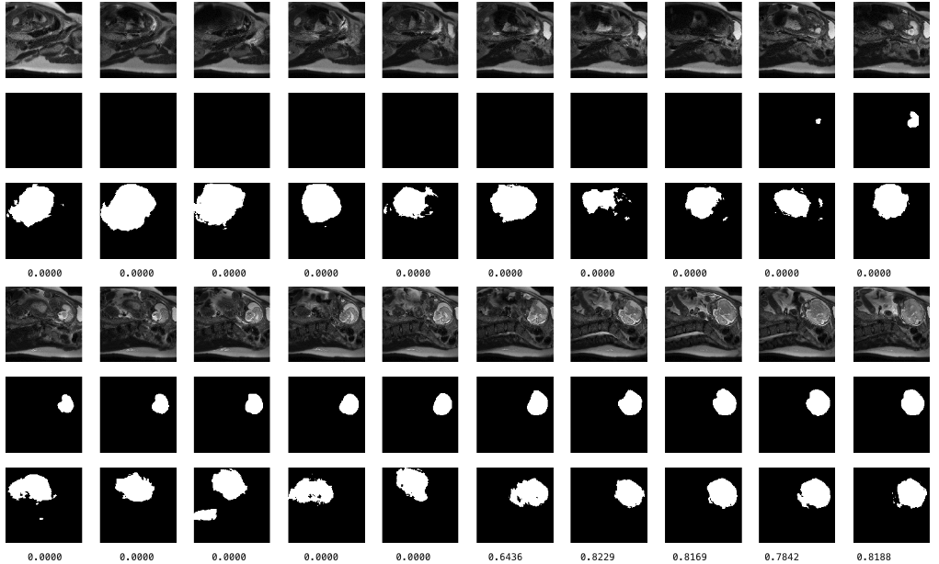
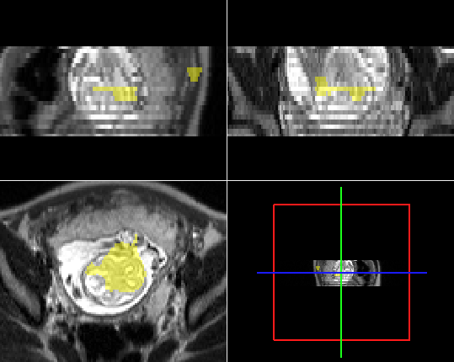

Tool 4: Automated Fetal Brain Extraction
2D Slices
3D Volume
Input Slice
Ground Truth
Prediction
Challenges: False positive tissues, missing slices, and lack of generalization to new contrast.
Input Slice
Ground Truth
What Should We Do?
Prediction

Slide 32
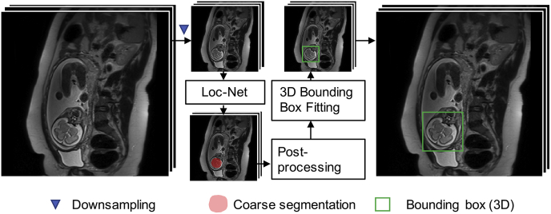
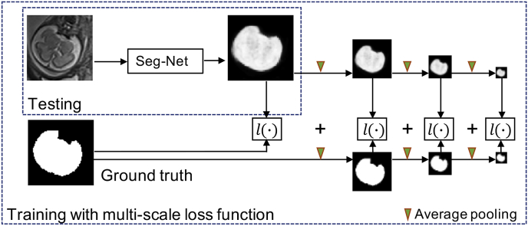
Tool 4: Automated Fetal Brain Extraction
Localization
Two-step approach: Localize, then segment.
Reduce false positives before U-Net segmentation.
Segmentation
Ebner, Michael, et al. "An automated framework for localization, segmentation and super-resolution reconstruction of fetal brain MRI." NeuroImage (2020).

Slide 33

Tool 4: Generalization
EPI Contrast
Trained on HASTE and tested on EPI contrast.
Lack of generalization

Slide 34

Tool 4: Synthetic Data
DL Models are Data-Hungry
Synthetic Data Enables
  Data Augmentation
  Overcoming Data Scarcity
  Reducing Bias
  Controlled Variability
Billot, Benjamin, et al. "SynthSeg: Segmentation of brain MRI scans of any contrast and resolution without retraining." Medical image analysis 86 (2023): 102789.

Slide 35


Tool 4: Synthetic Data for Fetal Images
Axis 0
Axis 1
Axis 2
40 Manually Labeled Fetal Brain Scans
Augmented with Random Shapes
Generate Unlimited Training Images
Label Maps

Slide 36




Tool 4: Examples of Synthetic Images
Axis 0
Axis 1
Axis 2
Axis 0
Axis 1
Axis 2
40 Manually Labeled Fetal Brain Scans
Augmented with Random Shapes
Generate Unlimited Training Images

Slide 37





Tool 4: High False Positive Rates
Axis 0
Axis 1
Axis 2
High False Positive Rates!
Don’t Generalize
Should We Try Different Backgrounds?

Slide 38




Tool 4: Complex Backgrounds
Axis 0
Axis 1
Axis 2
Axis 0
Axis 1
Axis 2

Slide 39


Tool 4: Bias-Variance Tradeoff
Challenging Training Doesn't Always Improve Generalization
Balance the Bias-Variance Tradeoff
Reduce False Positives During Testing!

Slide 40

Tool 4: Sliding Window
Classical sliding windows were used for detection tasks like face or abnormality detection.
A
A
Li, Haoxiang, et al. "A convolutional neural network cascade for face detection." Proceedings of the IEEE conference on computer vision and pattern recognition. 2015.

Slide 41


Tool 4: Sliding Window
Li, Haoxiang, et al. "A convolutional neural network cascade for face detection." Proceedings of the IEEE conference on computer vision and pattern recognition. 2015.

Slide 42


Tool 4: Sliding Window
Classical sliding windows were used for detection tasks like face or abnormality detection.
In our method, we apply voxel-wise segmentation.
This generates probability maps or weighted masks.
A
A
Weighted Mask

Slide 43








Tool 4: Breadth-First Search (BFS) and Deep Focused Sliding Windows (DFS)
Train four U-Nets for different window sizes
Include partial and absent brains in training data
A
B
$${96}^{3}$$
C
D
Sliding window
weighted mask
$${32}^{3}$$
$${64}^{3}$$
$${32}^{3}$$

Slide 44



Synthesis Ranges
We use 40 manually labeled fetal brain maps from FeTA 2021.
We select appropriate synthetic parameters for each model.
Model A
Model D

Slide 45


Tool 4: The Proposed BFS/DFS Framework
BFS identifies regions of interest (ROI)
DFS refines patches progressively
BFS
DFS
Input volume
Sub volume
A
D
B
C
A
D
Sliding window
3D volume
D
weighted mask

Slide 46
Outline
Functional Connectomes
  Tool 1: Visualization
  Tool 2: Statistical Tools
  Tool 3: Data-driven Methods with Optimal Transport
Fetus, Infant, and Toddler (FIT) Neuroimaging
  Tool 4: Automated Fetal Brain Extraction
Results & Final Remarks

Slide 47



Results & Final Remarks
Loc-Net
BFS/DFS
192-Net

Slide 48

Results & Final Remarks

Slide 49
Final Remarks
Key Contributions:
  Developed novel visualization tools for connectomics data.
  Accelerated the use of connectomics through data-driven methods with optimal transport.
  Proposed a new fetal brain extraction tool, achieving state-of-the-art results with synthetic data.

Slide 50









Final Remarks
Future Directions:
  Further refining segmentation to remove the age effect.
  Expanding testing to additional imaging modalities like PET/MR, body organ segmentation, and high-resolution reconstruction.
  Factor in motion in synthesizing images.
Acknowledgments:
  Special thanks to collaborators and institutions for their support in bringing this project forward: Dustin Scheinost, Amin Karbasi, Xenophon Papademetris, Stephanie Noble, Todd Constable, Bruce Fischl, Lilla Zollie, Camilo Jaimes, Malte Hoffmann

